Slide 1
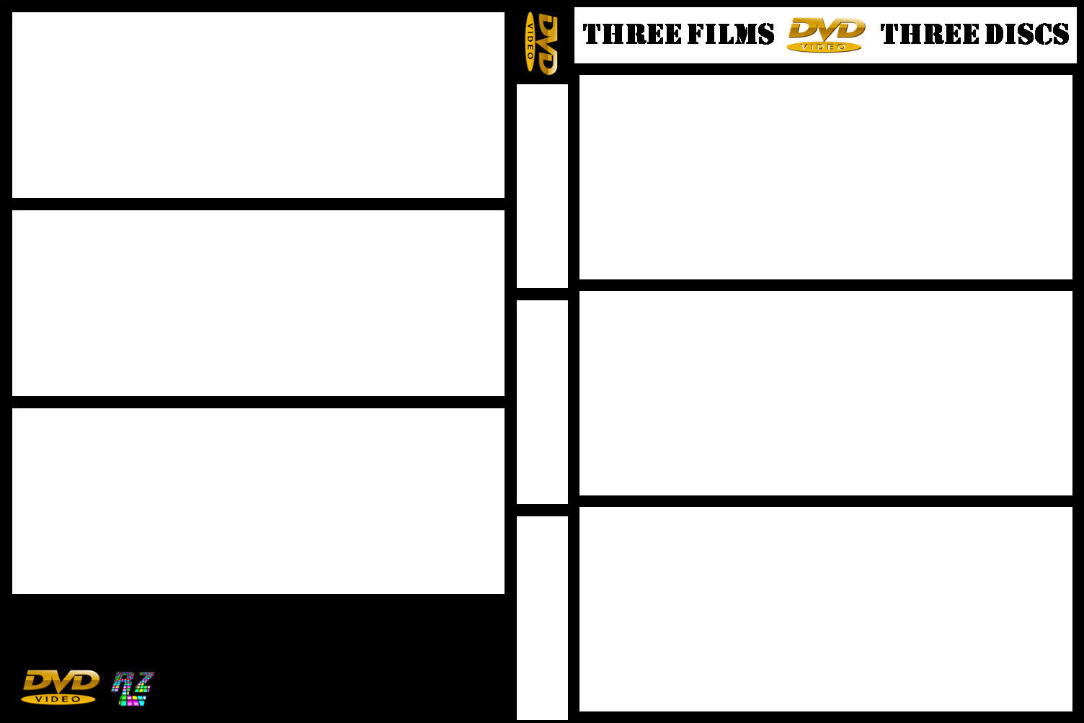










Notes:
Back Covers Image Size : Height – 4.45 cm / Width - 11.64 cm
Front Covers Image Size : Height – 4.87 cm / Width - 11.64 cm
Middle Cover Image Size : Height – 4.87 cm / Width - 1.27 cm
Remember Too Send The Image, To Back For The DVD Image. Free To Use No Copyright On This Image.

